Slide 1
[ Network Embedding ]
node2vec
Scalable Feature Learning for Networks
Seunghan Lee (CSE-URP) 20.02.17(Mon)

Slide 2
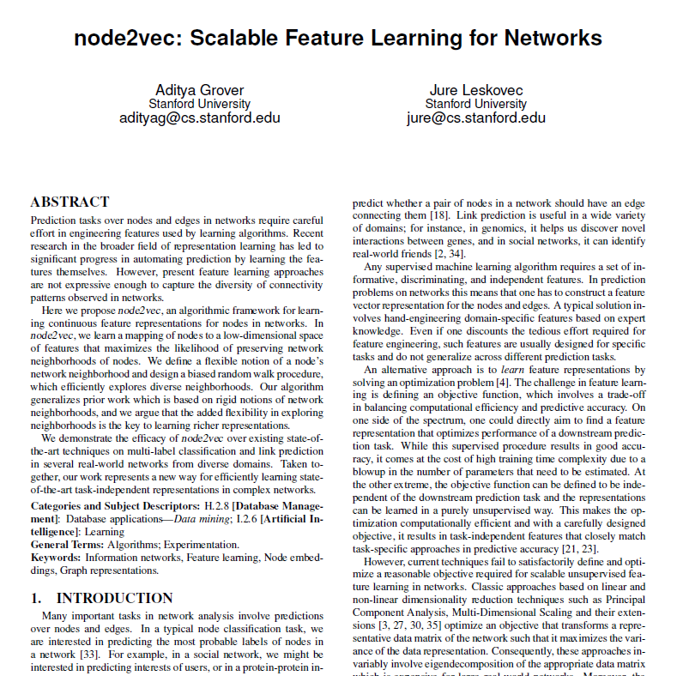
Goal
Summary of node2vec
1. node2vec algorithm
- about DFS & BFS
2. node2vec implementation
- with numpy
1

Slide 3
Contents
1
Introduction
Contribution of node2vec
2
node2vec algorithm
Classic Search Algorithm : BFS & DFS
Random Walk in node2vec
3
node2vec implementation
Embedding & Classification
2

Slide 4
1. Introduction
Contribution of node2vec
3

Slide 5
1. Introduction
contribution of node2vec
1. Efficient scalable algorithm for feature learning in networks ( using SGD )
2. Provides flexibility in discovering representations
3. Extend node2vec from ‘nodes’ to ‘edges’
4. Evaluate node2vec for (1) multi-label classification & (2) link prediction
4

Slide 6
1. Introduction
contribution of node2vec
1. Efficient scalable algorithm for feature learning in networks ( using SGD )
( SGD with “negative sampling” -> efficient in huge network )
2. Provides flexibility in discovering representations
3. Extend node2vec from ‘nodes’ to ‘edges’
4. Evaluate node2vec for (1) multi-label classification & (2) link prediction
4

Slide 7
1. Introduction
contribution of node2vec
1. Efficient scalable algorithm for feature learning in networks ( using SGD )
( SGD with “negative sampling” -> efficient in huge network )
2. Provides flexibility in discovering representations
( provides parameter to tune the explored search space -> BFS, DFS )
3. Extend node2vec from ‘nodes’ to ‘edges’
4. Evaluate node2vec for (1) multi-label classification & (2) link prediction
4

Slide 8
1. Introduction
contribution of node2vec
1. Efficient scalable algorithm for feature learning in networks ( using SGD )
( SGD with “negative sampling” -> efficient in huge network )
2. Provides flexibility in discovering representations
( provides parameter to tune the explored search space -> BFS, DFS )
3. Extend node2vec from ‘nodes’ to ‘edges’
( classic : node embedding -> node2vec : node embedding & edge embedding )
4. Evaluate node2vec for (1) multi-label classification & (2) link prediction
4

Slide 9
1. Introduction
contribution of node2vec
1. Efficient scalable algorithm for feature learning in networks ( using SGD )
( SGD with “negative sampling” -> efficient in huge network )
2. Provides flexibility in discovering representations
( provides parameter to tune the explored search space -> BFS, DFS )
3. Extend node2vec from ‘nodes’ to ‘edges’
( classic : node embedding -> node2vec : node embedding & edge embedding )
4. Evaluate node2vec for (1) multi-label classification & (2) link prediction
( (1) multi-label classification : classify which class the node belongs to ) ( (2) link prediction : predict if there is a link between to nodes )
4

Slide 10
1. Introduction
contribution of node2vec
1. Efficient scalable algorithm for feature learning in networks ( using SGD )
( SGD with “negative sampling” -> efficient in huge network )
2. Provides flexibility in discovering representations
( provides parameter to tune the explored search space -> BFS, DFS )
3. Extend node2vec from ‘nodes’ to ‘edges’
( classic : node embedding -> node2vec : node embedding & edge embedding )
4. Evaluate node2vec for (1) multi-label classification & (2) link prediction
( (1) multi-label classification : classify which class the node belongs to ) ( (2) link prediction : predict if there is a link between to nodes )
4

Slide 11
2. node2vec algorithm
Classic Search Algorithm : BFS & DFS
Random Walk in node2vec
5

Slide 12
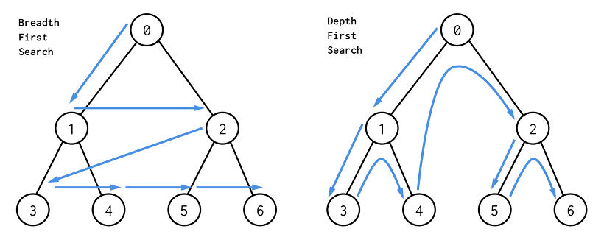
2. node2vec algorithm
1. Classic Search Algorithm : BFS & DFS
“An algorithm for traversing or searching tree or graph data structures” (wikipedia)
https://t1.daumcdn.net/cfile/tistory/997183445C7625B921
BFS ( Breadth-First Search )
DFS ( Depth-First Search )
6

Slide 13
2. node2vec algorithm
1. Classic Search Algorithm : BFS & DFS
BFS ( Breadth-First Search )
Search the node with the same level (breadth)! After finishing searching the certain level (breadth), get down to the below level (depth)!
https://seing.tistory.com/29
7

Slide 14
2. node2vec algorithm
1. Classic Search Algorithm : BFS & DFS
DFS ( Depth-First Search )
Search the child node first!
After finishing searching the last child node, “Backtracking” ( returning back to the parent node )
https://seing.tistory.com/29
8

Slide 15
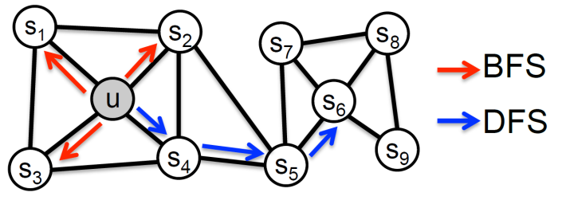
2. node2vec algorithm
1. Classic Search Algorithm : BFS & DFS
BFS & DFS in graph
9

Slide 16
2. node2vec algorithm
1. Classic Search Algorithm : BFS & DFS
How can these BFS/DFS algorithms
be applied in graph search of node2vec?
BFS & DFS in graph
9

Slide 17
2. node2vec algorithm
1. Classic Search Algorithm : BFS & DFS
before moving on…
In the phrase “Nodes with high similarity should be also embedded closely in the representative space”,
how can we define the word “similarity” ?
10

Slide 18
2. node2vec algorithm
1. Classic Search Algorithm : BFS & DFS
before moving on…
In the phrase “Nodes with high similarity should be also embedded closely in the representative space”,
how can we define the word “similarity” ?
“how to sample the random walk” is affected by “how we define ‘similarity’ ”
10

Slide 19
2. node2vec algorithm
1. Classic Search Algorithm : BFS & DFS
Two kinds of Similarity
1. Homophily
2. Structural Equivalence
nodes that are “highly interconnected” and belong to similar network clusters should be embedded closely together
nodes that have “similar structural roles” in networks should be embedded closely together
Node2vec_Scalable Feature Learning for Networks
Node2vec_Scalable Feature Learning for Networks
11

Slide 20
2. node2vec algorithm
1. Classic Search Algorithm : BFS & DFS
Two kinds of Similarity
1. Homophily
2. Structural Equivalence
nodes that are “highly interconnected” and belong to similar network clusters should be embedded closely together
nodes that have “similar structural roles” in networks should be embedded closely together
Networks
in the similar space inside its own network
Node2vec_Scalable Feature Learning for Networks
Node2vec_Scalable Feature Learning for Networks
11

Slide 21
2. node2vec algorithm
KOREA
1. Classic Search Algorithm : BFS & DFS
U.S
Two kinds of Similarity
1. Homophily
2. Structural Equivalence
nodes that are “highly interconnected” and belong to similar network clusters should be embedded closely together
nodes that have “similar structural roles” in networks should be embedded closely together
Networks
Networks
JAPAN
(Network) Homophily : - similar networks -> embedded closely
- ex) Korea,Japan <-> U.S
Structural Equivalence : - nodes with similar role (ex.hub) -> should be embedded in the similar space - ex) ‘capital’ of each country should be located “UP-LEFT” in its own cluster
Node2vec_Scalable Feature Learning for Networks
Node2vec_Scalable Feature Learning for Networks
11

Slide 22
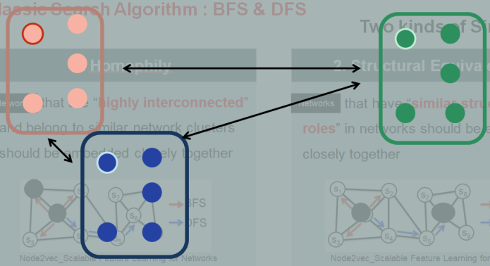
2. node2vec algorithm
1. Classic Search Algorithm : BFS & DFS
BFS & DFS in node2vec
DFS (Depth-first Sampling) - neighborhood : nodes sequentially sampled at increasing distance from the source node
macro view
to capture “homophily”
BFS (Breadth-first Sampling) - neighborhood : only immediate neighbors of the source node
micro view
to capture “structural equivalence”
12

Slide 23
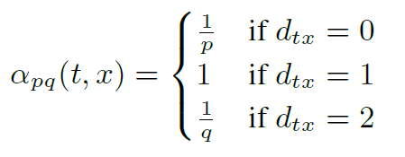
2. node2vec algorithm
2. Random Walk in node2vec
Considers both “homophily” and “structural equivalence”
( with DFS )
( with BFS )
These two similarities are not exclusive!
Introduce a “search bias” term
( Define a “second order random walk” with two parameters p & q )
13

Slide 24
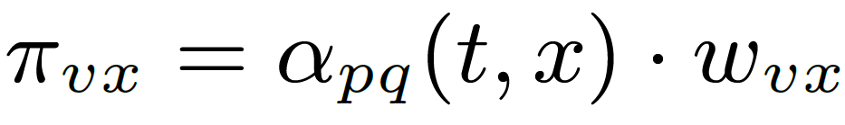

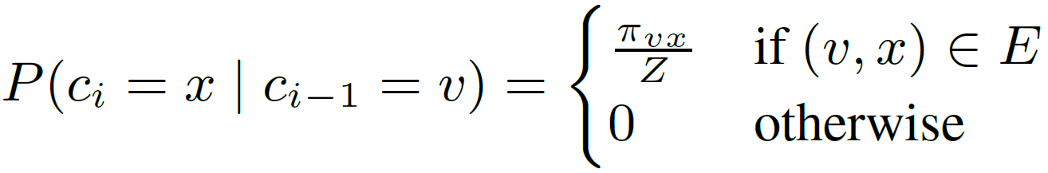
2. node2vec algorithm
2. Random Walk in node2vec
Transition probability
Search bias
Weight of edge
normalize
14

Slide 25
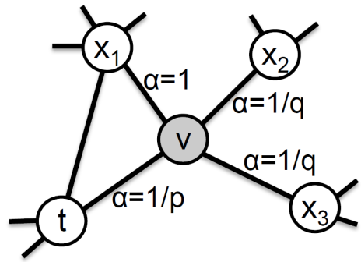
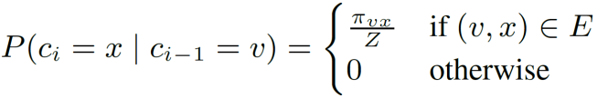
2. node2vec algorithm
2. Random Walk in node2vec
Search bias
t : previous node / v : current node / x : node to choose as the next step
Consider the previous node(t) to sample the next node!
15

Slide 26
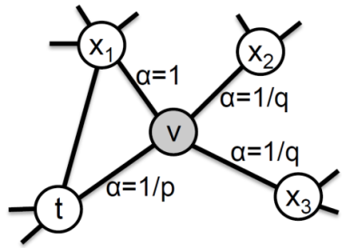
2. node2vec algorithm
2. Random Walk in node2vec
return parameter, p
If p > max(q,1) : getting further from the previous node! DFS If p < min(q,1) : getting closer to the previous node ( Local search ) BFS
return parameter, q
If q > 1: getting closer to the previous node! BFS
If q < 1: getting further from the previous node! DFS
16

Slide 27
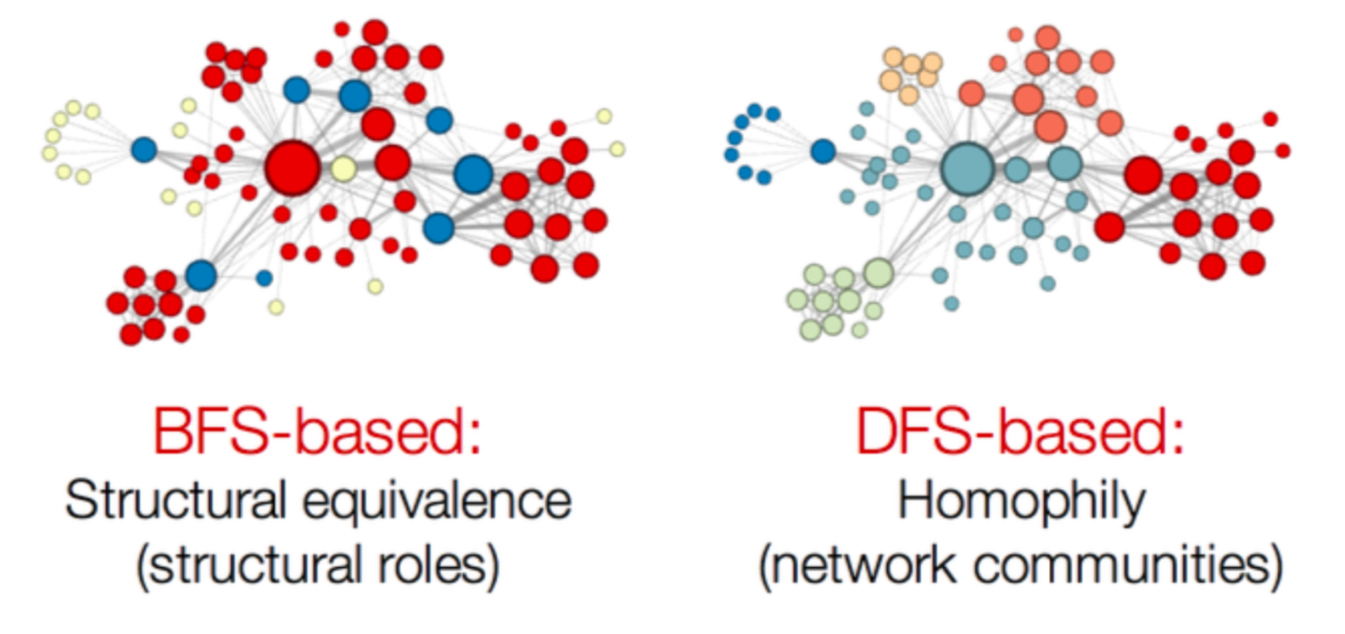
2. node2vec algorithm
2. Random Walk in node2vec
http://nocotan.github.io/images/20170701/fig2.png
Tune p & q to choose the similarity to focus on!
17

Slide 28
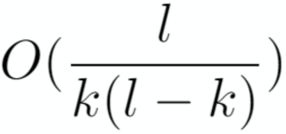


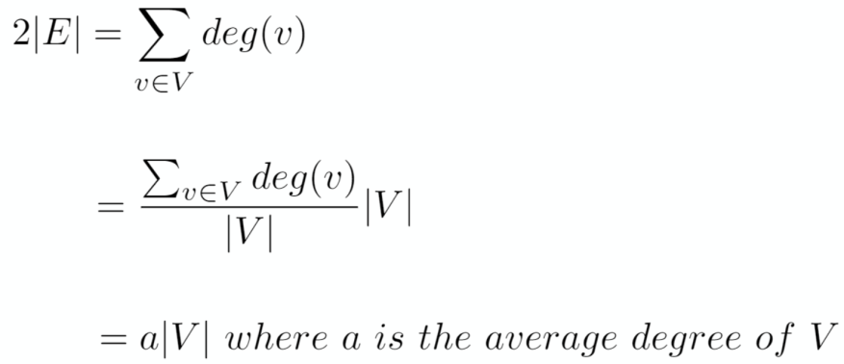

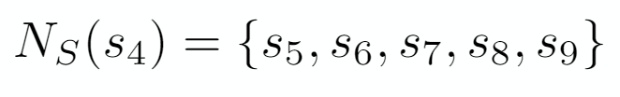
2. node2vec algorithm
2. Random Walk in node2vec
Benefits of Random Walk
참고 : Node2vec(서창원)
Space complexity
Time complexity
Space complexity to store immediate neighbors :
18

Slide 29
3. node2vec implementation
Embedding
Classification with MLP & Logistic Regression
19

Slide 30
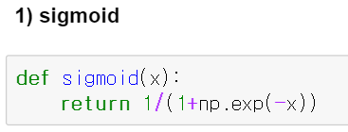
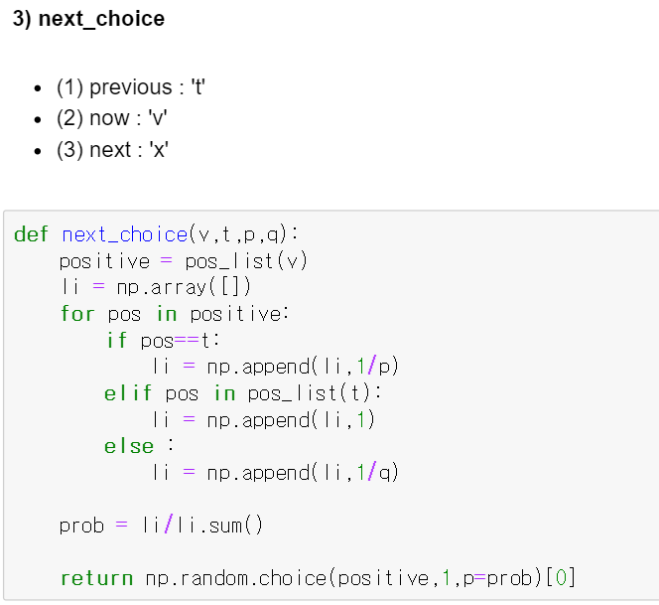
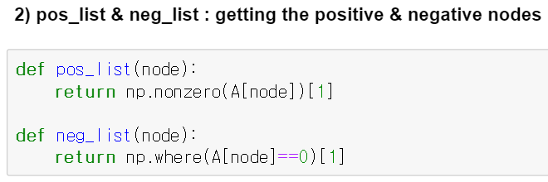
3. node2vec implementation
1. Embedding
1
3
Sigmoid function
2
Choosing the next step, based on transition probability (considering search bias)
Getting the positive & negative nodes
20

Slide 31
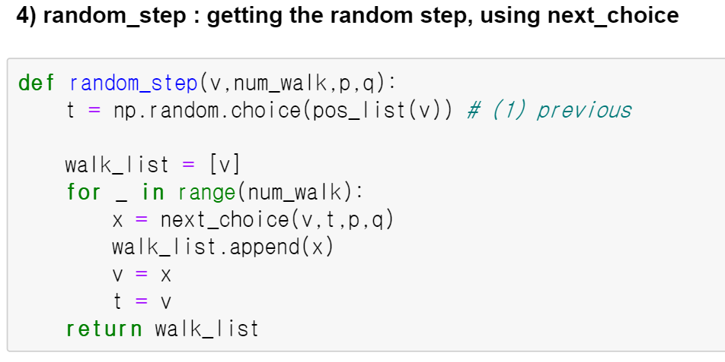
3. node2vec implementation
1. Embedding
4
Random Step : make the random step of length ‘num_walk’,
based on ‘next_choice’ (considering BFS &DFS)
21

Slide 32
3. node2vec implementation
1. Embedding
4
sigmoid
1
pos_list & neg_list
2
next_choice
3
random_step
4
Random Step : make the random step of length ‘num_walk’,
based on ‘next_choice’ (considering BFS &DFS)
node2vec
21

Slide 33
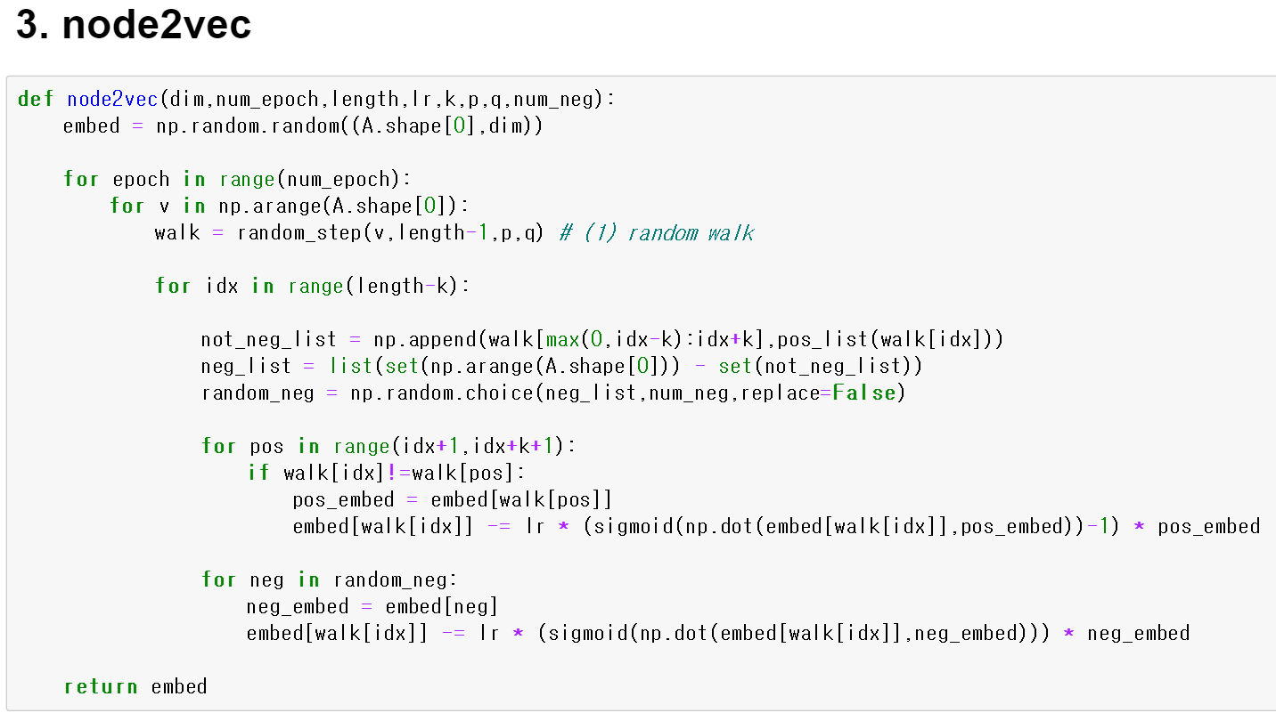
3. node2vec implementation
1. Embedding
input
- dim ( dimension to reduce )
- num_epoch ( number of epoch )
- length ( walk length )
- lr ( learning rate )
- k ( context size a)
- p & q ( parameter for search bias )
- num_neg ( number of negative samples )
1. Take random step ( with length ‘length’ ).
2. Negative sampling ( with size ‘num_neg’ )
3. Update with “positive” samples
4. Update with “negative” samples
output
Embedded Vector
22

Slide 34
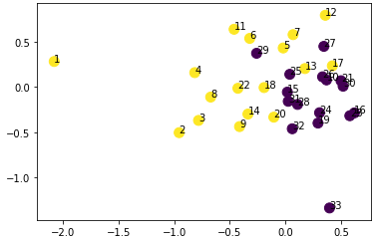
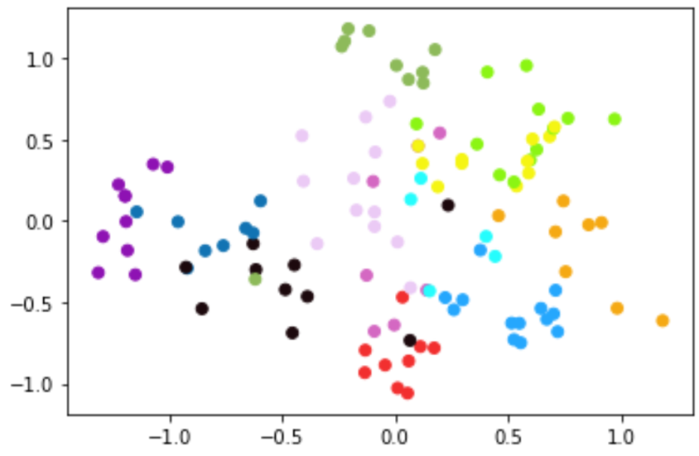

3. node2vec implementation
1. Embedding
Result : Embedded into 2-dimension
c
1. Karate
2. Football
23

Slide 35
3. node2vec implementation
2. Classification
1) Karate ( Logistic Regression & MLP )
2) Football ( OVR & MLP )
( + comparison with other methods )
( 참고 : Node2vec_project(김주현) )
24

Slide 36
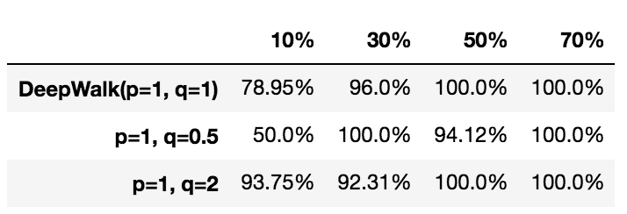
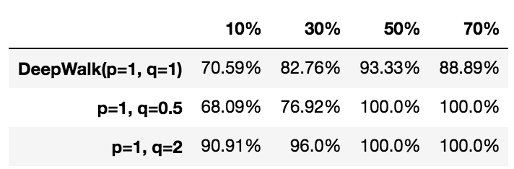
3. node2vec implementation
2. Classification
1) Karate ( Logistic Regression & MLP )
Logistic Regression
( epoch = 800, lr = 0.05 )
Multi Layer Perceptron
(epoch = 1000, lr = 0.001 )
25

Slide 37
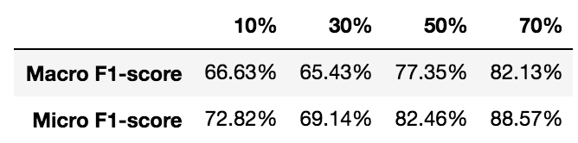
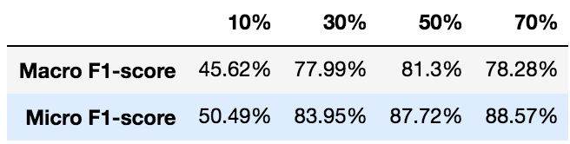
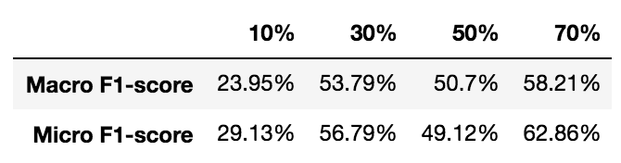
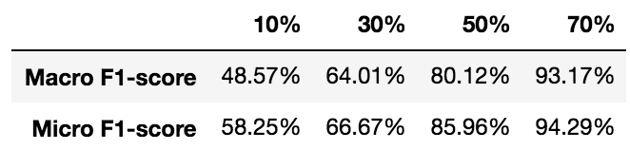
3. node2vec implementation
2. Classification
2) Football ( OVR & MLP )
(1) OVR
DeepWalk
Line with First Order Proximity
Line with Second Order Proximity
Node2Vec
26

Slide 38
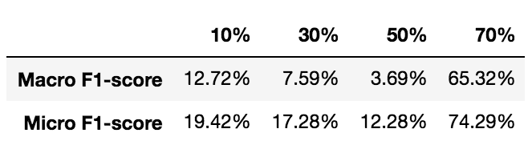
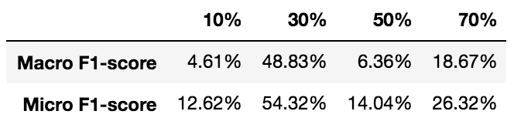
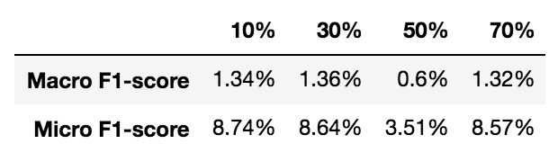
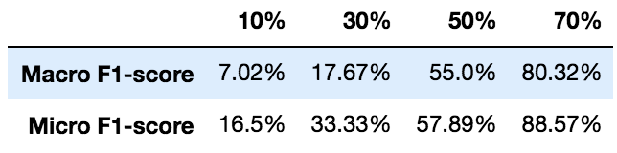
3. node2vec implementation
2. Classification
2) Football ( OVR & MLP )
(2) MLP
DeepWalk
Line with First Order Proximity
Line with Second Order Proximity
Node2Vec
27

Slide 39
Reference
[1] Aditya Grover : node2vec : Scalable Feature Learning for Networks
[2] 서창원 : node2vec
[3] 김주현 : node2vec project
28

Slide 40
Thank You!!

